Slide 1
Online Graduate Students of Color:
Advancement Toward Degree Attainment
Dr. Timberly Baker
Dr. Audrey Bowser
Dr. Kimberley Davis
Learn@State
March 4, 2020
Notes:
Research indicates that more and more higher education institutions are expanding their online course offerings, particularly at the graduate level. Given that the graduate students are at a distance, geographically and temporally, and that knowledge and relationships are being constructed through technology, it is important to know what impact this mode of delivery has or had on the proportional representation of students of color. In this presentation, we address a singular research question: Is online degree attainment more accessible for graduate students of color?
The purpose of this research is to determine whether online learning enhances minority participation in education leadership graduate programs toward degree attainment. The research will also investigate factors that contribute to the success of graduates in the program through an examination of race, gender, major/licensure, grades, and career placement of graduates regarding program completion. Ultimately, we posit that online education degree attainment is more accessible to graduate students of color and therefore, can be an avenue to train, recruit and retain more people of color into the varied education professions.

Slide 2

ELCSE Online Programs
Is online degree attainment more accessible for graduate students of color?

Slide 3
CoEBS Graduate Programs
3
The University System – More than 22,000 students in 90 undergraduate and graduate fields in 9 different colleges
College of Education & Behavioral Science http://www.astate.edu/college/education/
Overall enrollment of graduate students in the CoEBS is approximately 2947
Of the 2947/2744 are in online programs

Slide 4
Program Description
5 online programs in ELCSE
  Building Administration
  District Administration
  Curriculum Director
  SPED Director
  Gifted & Talented Director
Racial diversity of faculty is 12.9% in the Professional Education Unit

Slide 5
Our Challenge
To a lingering problem in the State of Arkansas
NEED FOR WELL PREPARED
AND HIGH PERFORMING
EDUCATORS OF COLOR IN OUR SCHOOLS

Slide 6
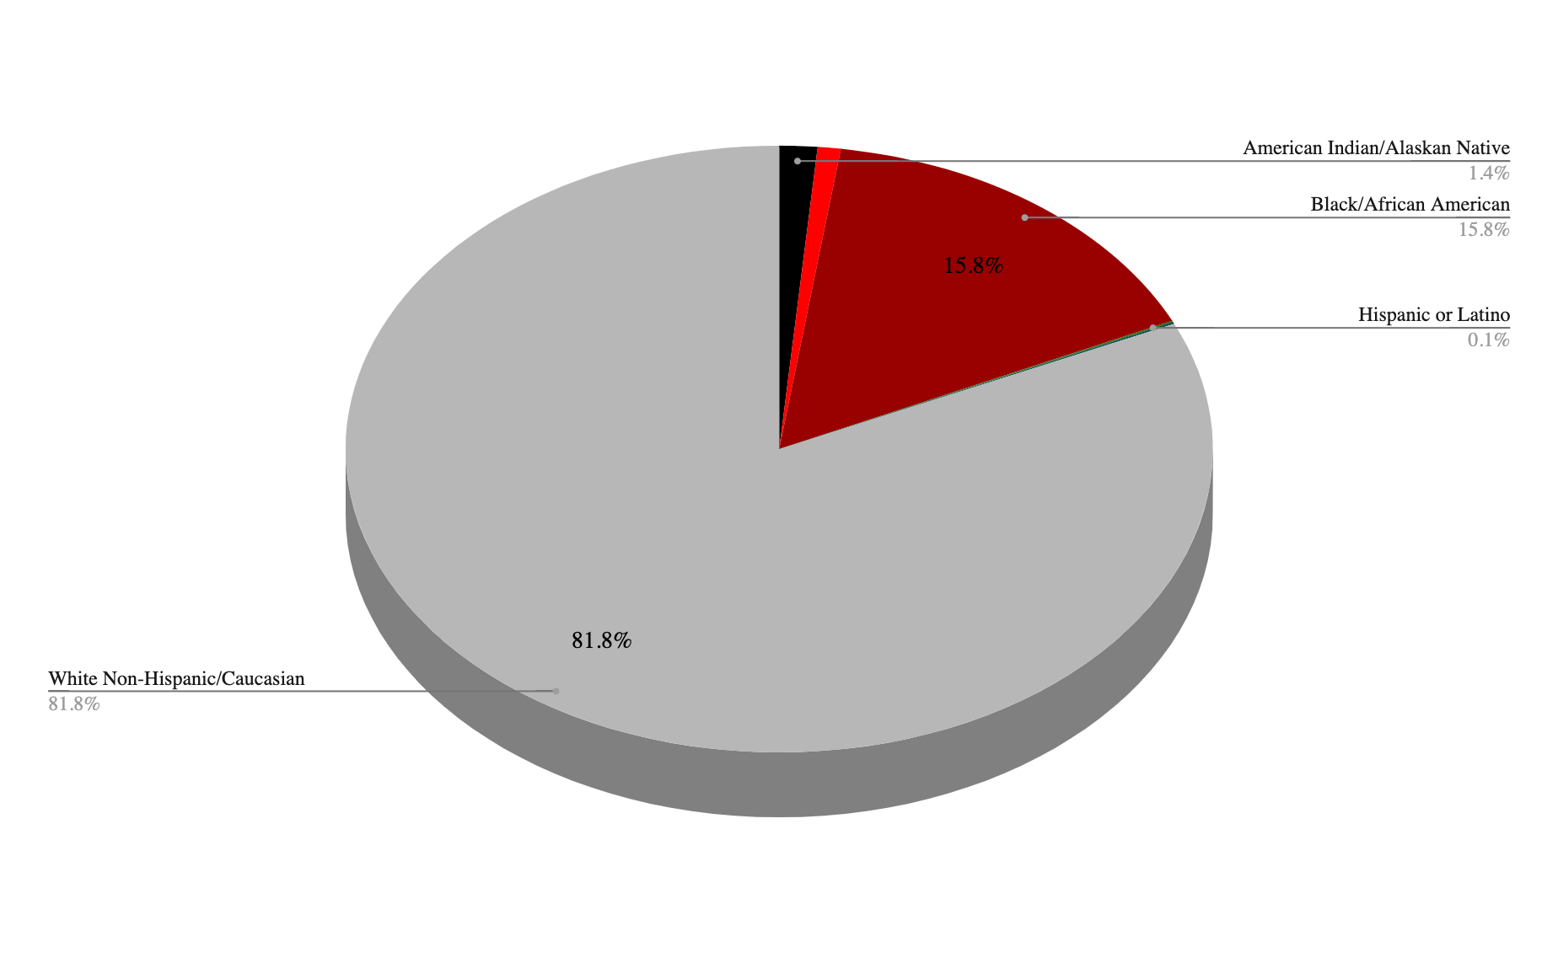
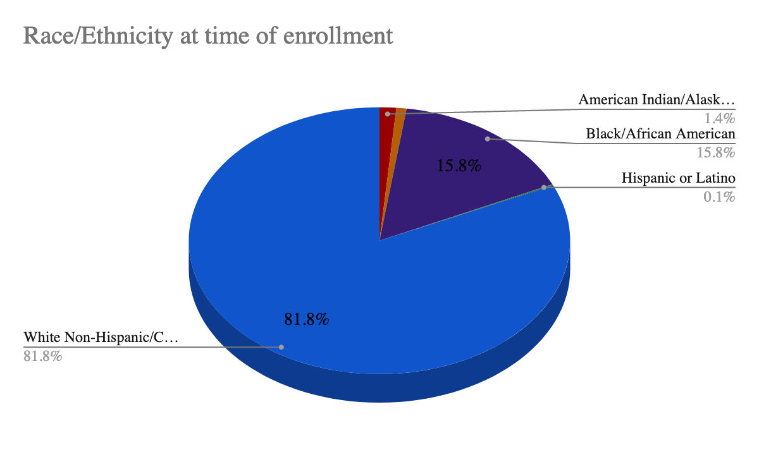
Fall 2019 Enrollment
Educational Leadership

Slide 7
Recommendations
State: Closely monitor the implementation of legislation enacted to strengthen educator preparation, recruitment, development and retention.
CoEBS: Develop a comprehensive action plan to address the critical shortage of educators of color.
ELCSE: Intentional recruitment and retention of candidates of color that represent the demographics of P-12 school populations.

Slide 8
Dr. Timberly Baker, Associate Professor
tibaker@astate.edu
Dr. Audrey Bowser, Associate Professor
abowser@astate.edu
Dr. Kimberley Davis, Associate Professor
kimberleydavis@astate.edu
Presenter Contact Information

